Slide 1

EMPLOYEE ATTRITION DASHBOARD

Slide 2
1
INTRODUCTION
XYZ Company, established a few years ago, is struggling with a 15% attrition rate, affecting its operations. To tackle this issue, the company has sought the expertise of an HR analytics consultancy. As the HR analyst, I am creating a dashboard to analyze employee data and uncover the reasons behind the high turnover. This dashboard will enable the company to make informed, data-driven decisions to reduce attrition.

Slide 3
2
DETAILS OF DATA
EmployeeID
Department
EmployeeCount
Age
DistanceFromHome
Gender
Attrition
Education
JobLevel
BusinessTravel
EducationField
JobRole

Slide 4
3
MAIN KPIS
Total Employees
Attrition Rate
Average Age
Average Age in Company
Gender Distribution
Attrition Rate by Marital Status
Attrition Rate by Job Role and Gender
Attrition Rate by Education Field
Attrition Rate by Age Group
Attrition Rate by Gender

Slide 5
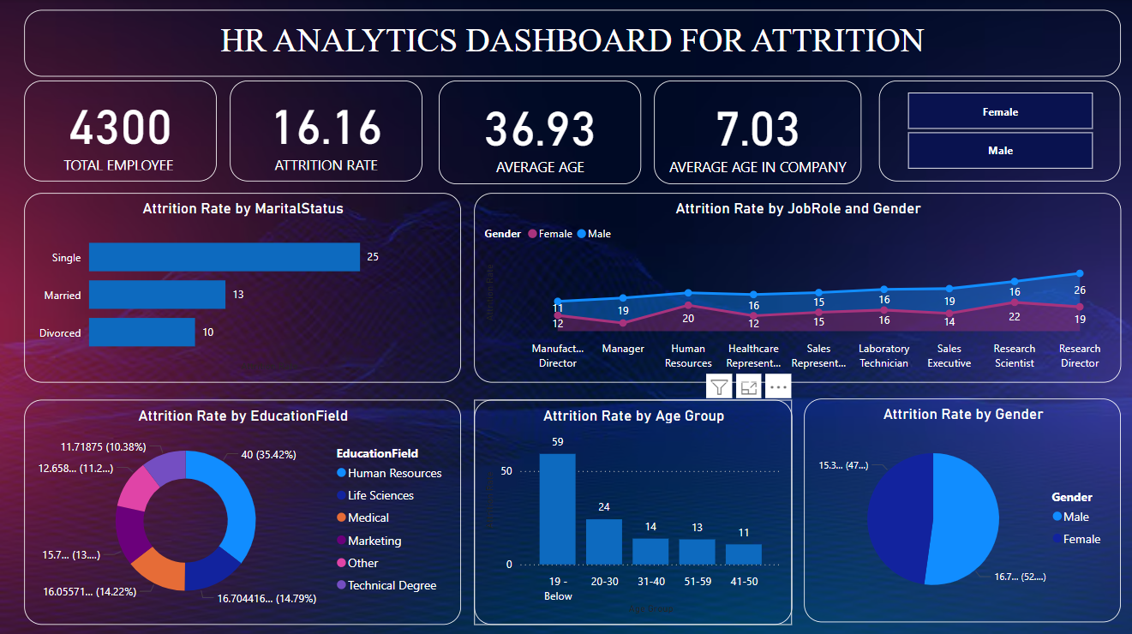
4
MY DESIGN

Slide 6
THANK YOU

